Slide 1
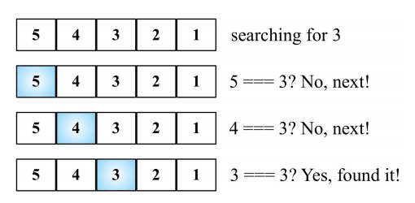
LINEAR SERACH
TIME COMPLEXITY Best case:O(1)-the target element is found at the beginning of the array
Worst case:O(n)-the target element is at the end of the array or not present within the array
Average case:O((n+1)/2)

Slide 2
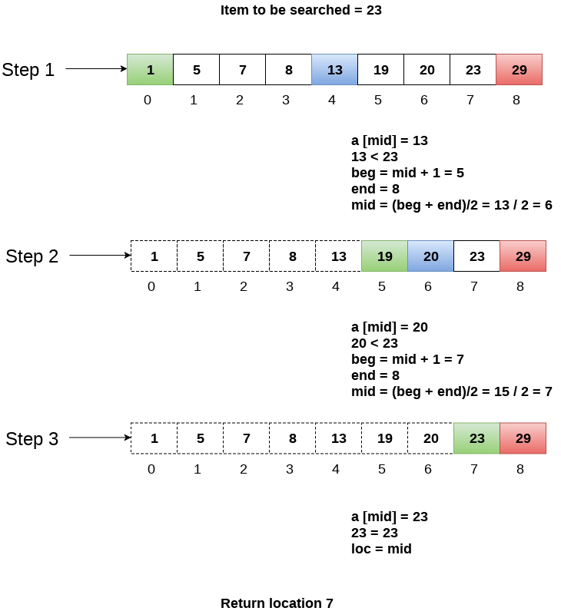
BINARY SEARCH
TIME COMPLEXITY Best case:O(1)-middle element is the target element
Worst case:O(logn)-the process of dividing the array in half continues until there is only one item left to check
Average case:O(logn)

Slide 3
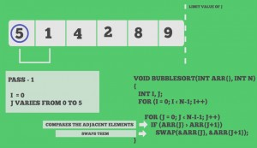
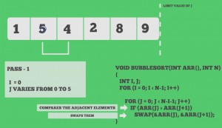
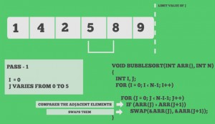
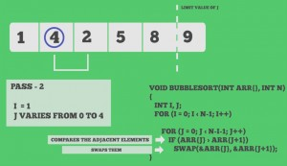
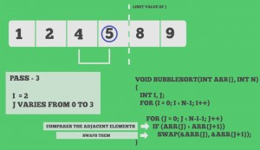
BUBBLE SORT

Slide 4
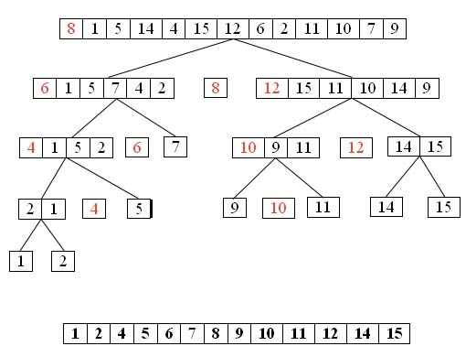
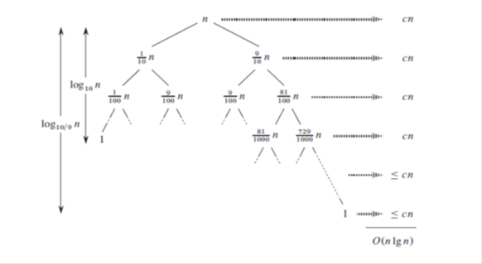
QUICK SORT
TIME COMPLEXITY:
Best case:O(nlogn)
Worst case:O(n²)
Average case:O(nlogn)

Slide 5
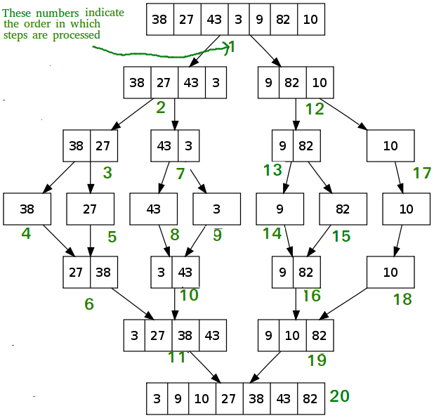
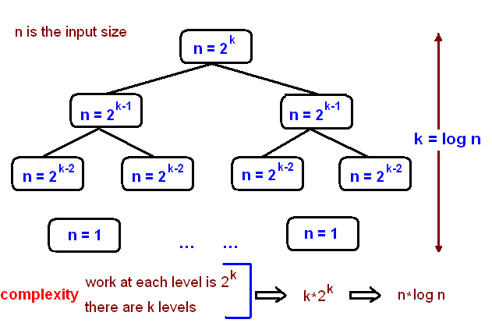
MERGE SORT
TIME COMPLEXITY:
Best case:O(nlogn)
Worst case:O(nlogn)
Average case:O(nlogn)

Slide 6
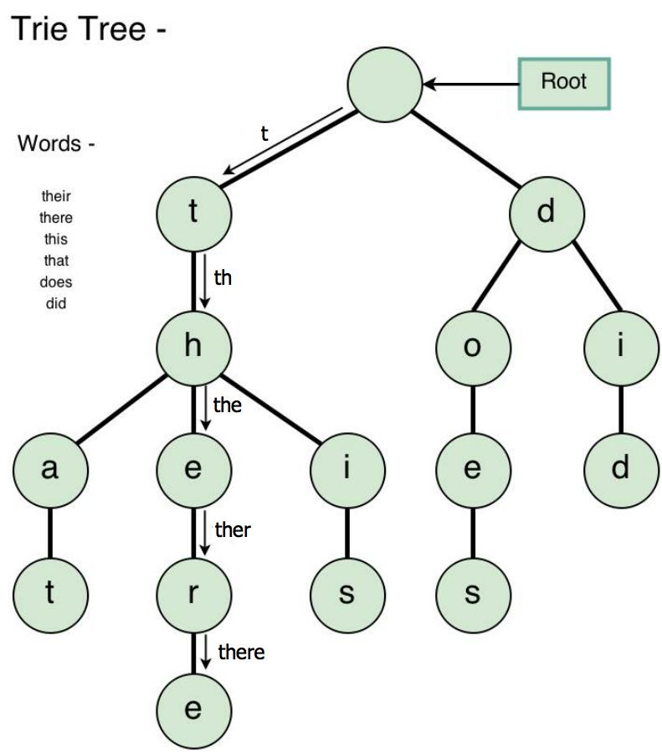
TRIE SEARCH
TIME COMPLEXITY: O(W*L)
W-no of words
L-average length of the word

Slide 7
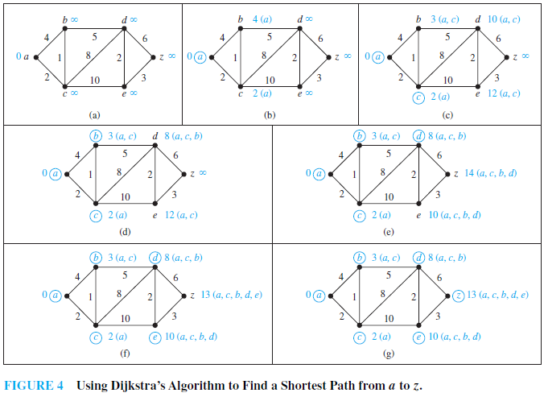
DIJKSTRA ALGORITHM
TIME COMPLEXITY:
O(n²) -represents a function whose complexity is directly proportional to the square of the input size.

Slide 8
APPLICATIONS:
LINEAR SEARCH:when the array has only a few elements or when performing a single search in an unordered array.
BINARY SEARCH:when the array is sorted it provides information about the location of the target this can be used to narrow the search.For example, imagine that we want to find the minimum size needed for a square office that must freely accommodate all the employees of a company. We can perform a binary search for that size rather than sequentially checking all the possible sizes. We usually estimate the minimum and maximum sizes over which we do a binary search. Next, we just check some middle value and the interval can be halved again, and so on. That’s a lot of saved time.
QUICK SORT :commercial computing is used in various government and private organizations for the purpose of sorting various data like sorting files by name/date/price, sorting of students by their roll no., Sorting of account profile by given id, etc.The sorting algorithm is used for information searching and as quicksort is the fastest algorithm so it is widely used as a better way of searching.
Merge sort :merge sort is useful for sorting linked lists in o(nlogn) time.In the case of linked lists, the case is different mainly due to the difference in memory allocation of arrays and linked lists. Unlike arrays, linked list nodes may not be adjacent in memory. Unlike an array, in the linked list, we can insert items in the middle in O(1) extra space and O(1) time. Therefore, the merge operation of merge sort can be implemented without extra space for linked lists.
TRIE SEARCH: search engine results optimization,data analytics,sentimental analysis.
DIJKSTRA ALGORITHM :It can be used in traffic routing protocols,online maps,flighting agenda,social media applications.

